Slide 1

Business Model & Value Proposition
PulseFIT: E-Commerce Gym Equipment

Slide 2
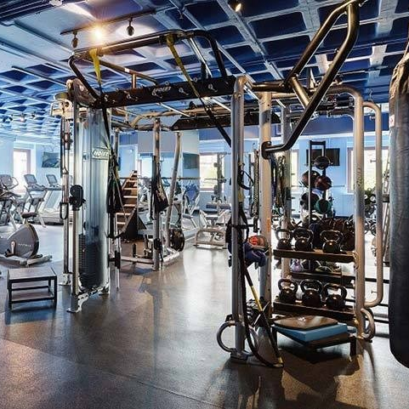
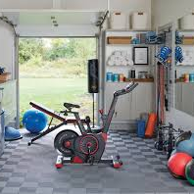
PulseFIT: E-Commerce Gym Equipment
Business Model: business-to-Consumer (BC) business-to-business
Target Market: Home fitness enthusiasts & commercial gym owners
Product Offerings:
Home Gym Equipment: Dumbbells, resistance bands, compact treadmills
Commercial Gym Equipment: Heavy-duty treadmills, multi-station systems
Key Value Propositions:
High-quality products with durability assurance
Affordable pricing with discounts
Easy online ordering & reliable delivery

Slide 3

Revenue, Market Strategy & Competitive Edge
Revenue Strategy:
Direct equipment sales (home & commercial)
Bulk purchasing for gym owners
Seasonal promotions & referral incentives
Marketing Strategy:
SEO & content marketing for brand visibility
Social media & PPC advertising
Email & referral programs
Competitive Differentiation:
Dual-market approach (home & commercial)
Personalized customer service & bulk order support
High durability & customized gym setup solutions

Slide 4
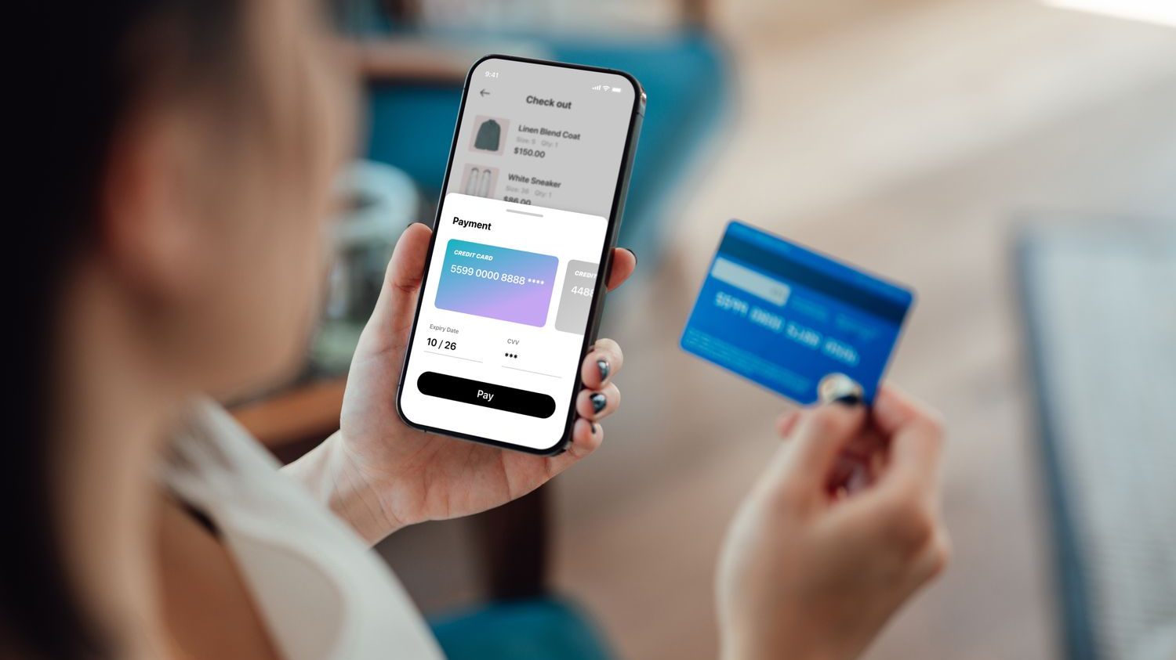
Payment Options
Payment Options:
Credit/Debit Cards, Bank Transfers
Customer Experience Enhancements:
easy returns
Business consultation for gym owners

Slide 5
conclusion
PulseFIT meets growing fitness demands in South Africa
Strong focus on quality, customer service & marketing
Competitive positioning as a trusted gym equipment provider

